Slide 1
Welcome to the
Workshop
Meeting

Slide 2
Introductions:
Ralph Lavansky ralphlavansky@yahoo.com
Linelle Johnson linellerjohnson@gmail.com
Jack Weidenbach uijack@yahoo.com
Eric Strandjord estrandjord@gmail.com
These fellows can help you...
Familiarize you with the workshop.
Help you start a project.
Familiarize you with the tools and machines, big and small.
Offer ”best practices” for using various machines.
They can only do so much. Your safety is ultimately your responsibility!
The workshop should be a “nanny free” environment.
Get you in touch with a mentor.

Slide 3
What the volunteers have been up to.
Helping organize the workshop since 2022!
First goal was to determine what might be donated, and then manage who brings what!
Some large power tools require special handling.
Many other cooperatives ended up with piles of duplicate tools and equipment!
At AWP meetings, gathered names of those who expressed interest in the workshop.
Maintained a private email list (available by request only) of those ~35 members.
Published information, pictures, news, and a few surveys via a simple website.
Organized meetings of the ~35 and maintained email contact (with a few emailed questionnaires) to gather ideas to have a great workshop and better serve the Cooperative.

Slide 4
What the volunteers have been up to.
Our volunteer’s mission was to ensure that our workshop would be…
Fun to use.
Functional for beginners through pros
Well equipped.
Safe.
Traveled to other cooperatives to learn what works and does not.
Published pictures of the other workshops visited.
Created draft documentation. (To be final when we have a board.)
Users Manual.
Safety Rules with Waiver. (AWP requires it.)
A few drawings of the shop, and a bit of information about the building.

Slide 5
How is our workshop different from other common areas, and what limitations are there?
Unlike our nice library, club room, exercise room, and others…
The workshop has some potentially dangerous machinery that require a user to be familiar with the operational and safety requirements of each one.
Even if we might be very experienced with a certain type of machine, our workshop’s make and model are most likely different so familiarization is required.
Example: We have two very nice band saws, but they are different.
Blade tensioning looks the same from a distance but operates very differently.
Our volunteers had to “cross train” each other just to get started.
We have volunteers who will gladly help anyone get started with the “big stuff”.
Our workshop is heated, ventilated, and air conditioned.
It does not have a industrial ventilation system. So NO spray painting (for now).
We would have to build a “booth” with a proper filtration system that captures volatiles, aerosols, and particulates, so they don’t clog up the ventilation system or cause an explosion!
The workshop is not maintained by our fine building staff! We must...
Buy our own materials, supplies, and other consumables.
Replace breakage, or just something we wear out.
Clean up our own messes!

Slide 6
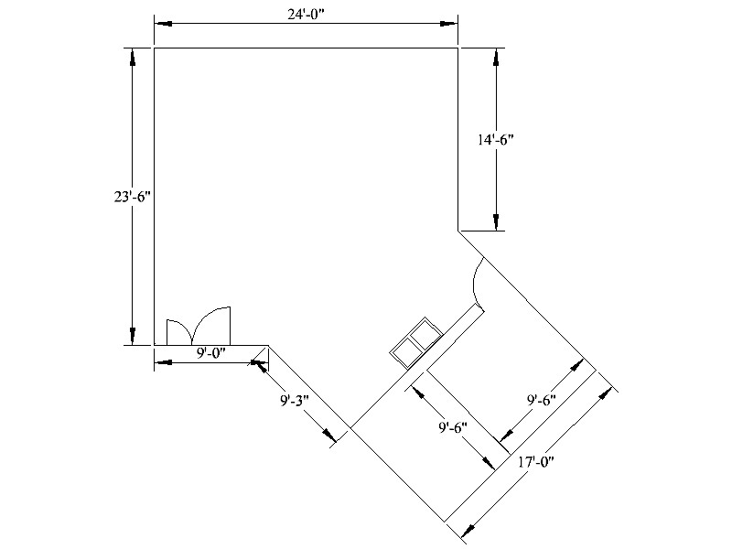

Slide 7
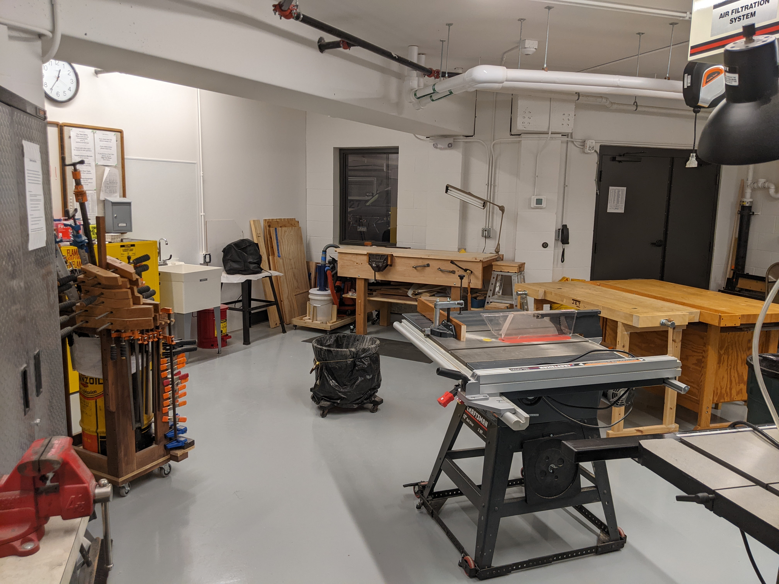

Slide 8
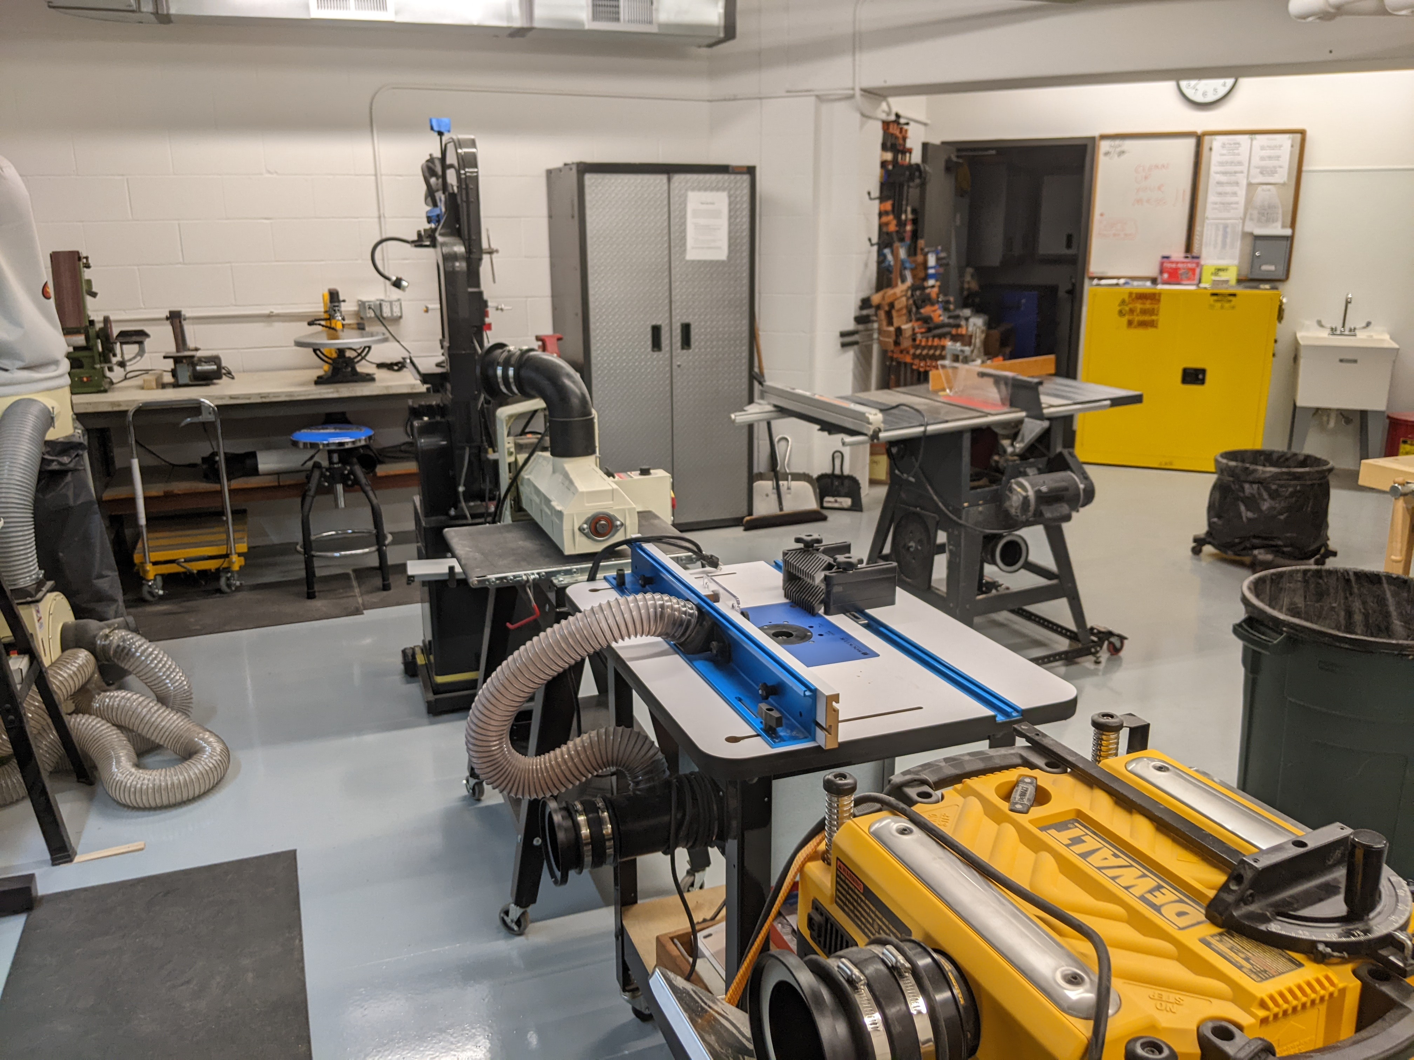

Slide 9
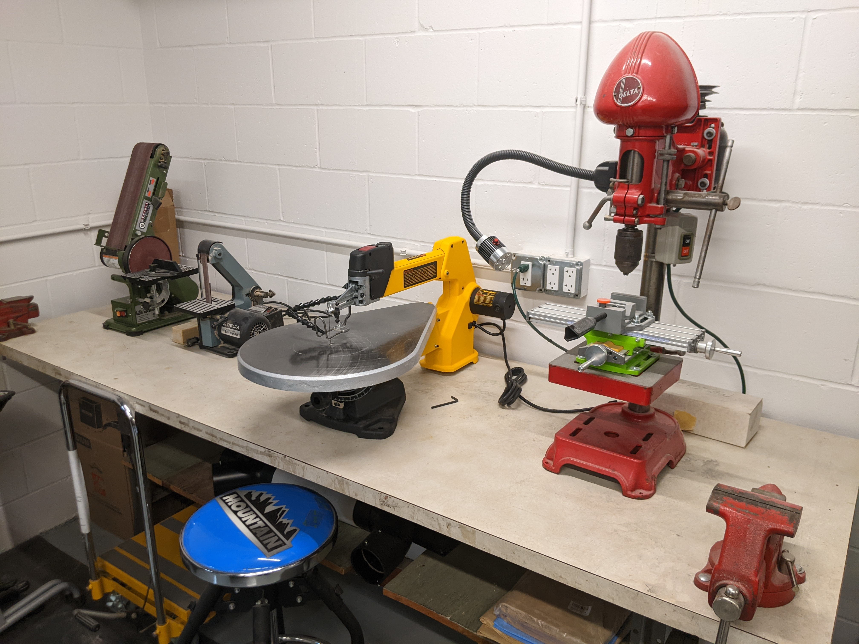

Slide 10
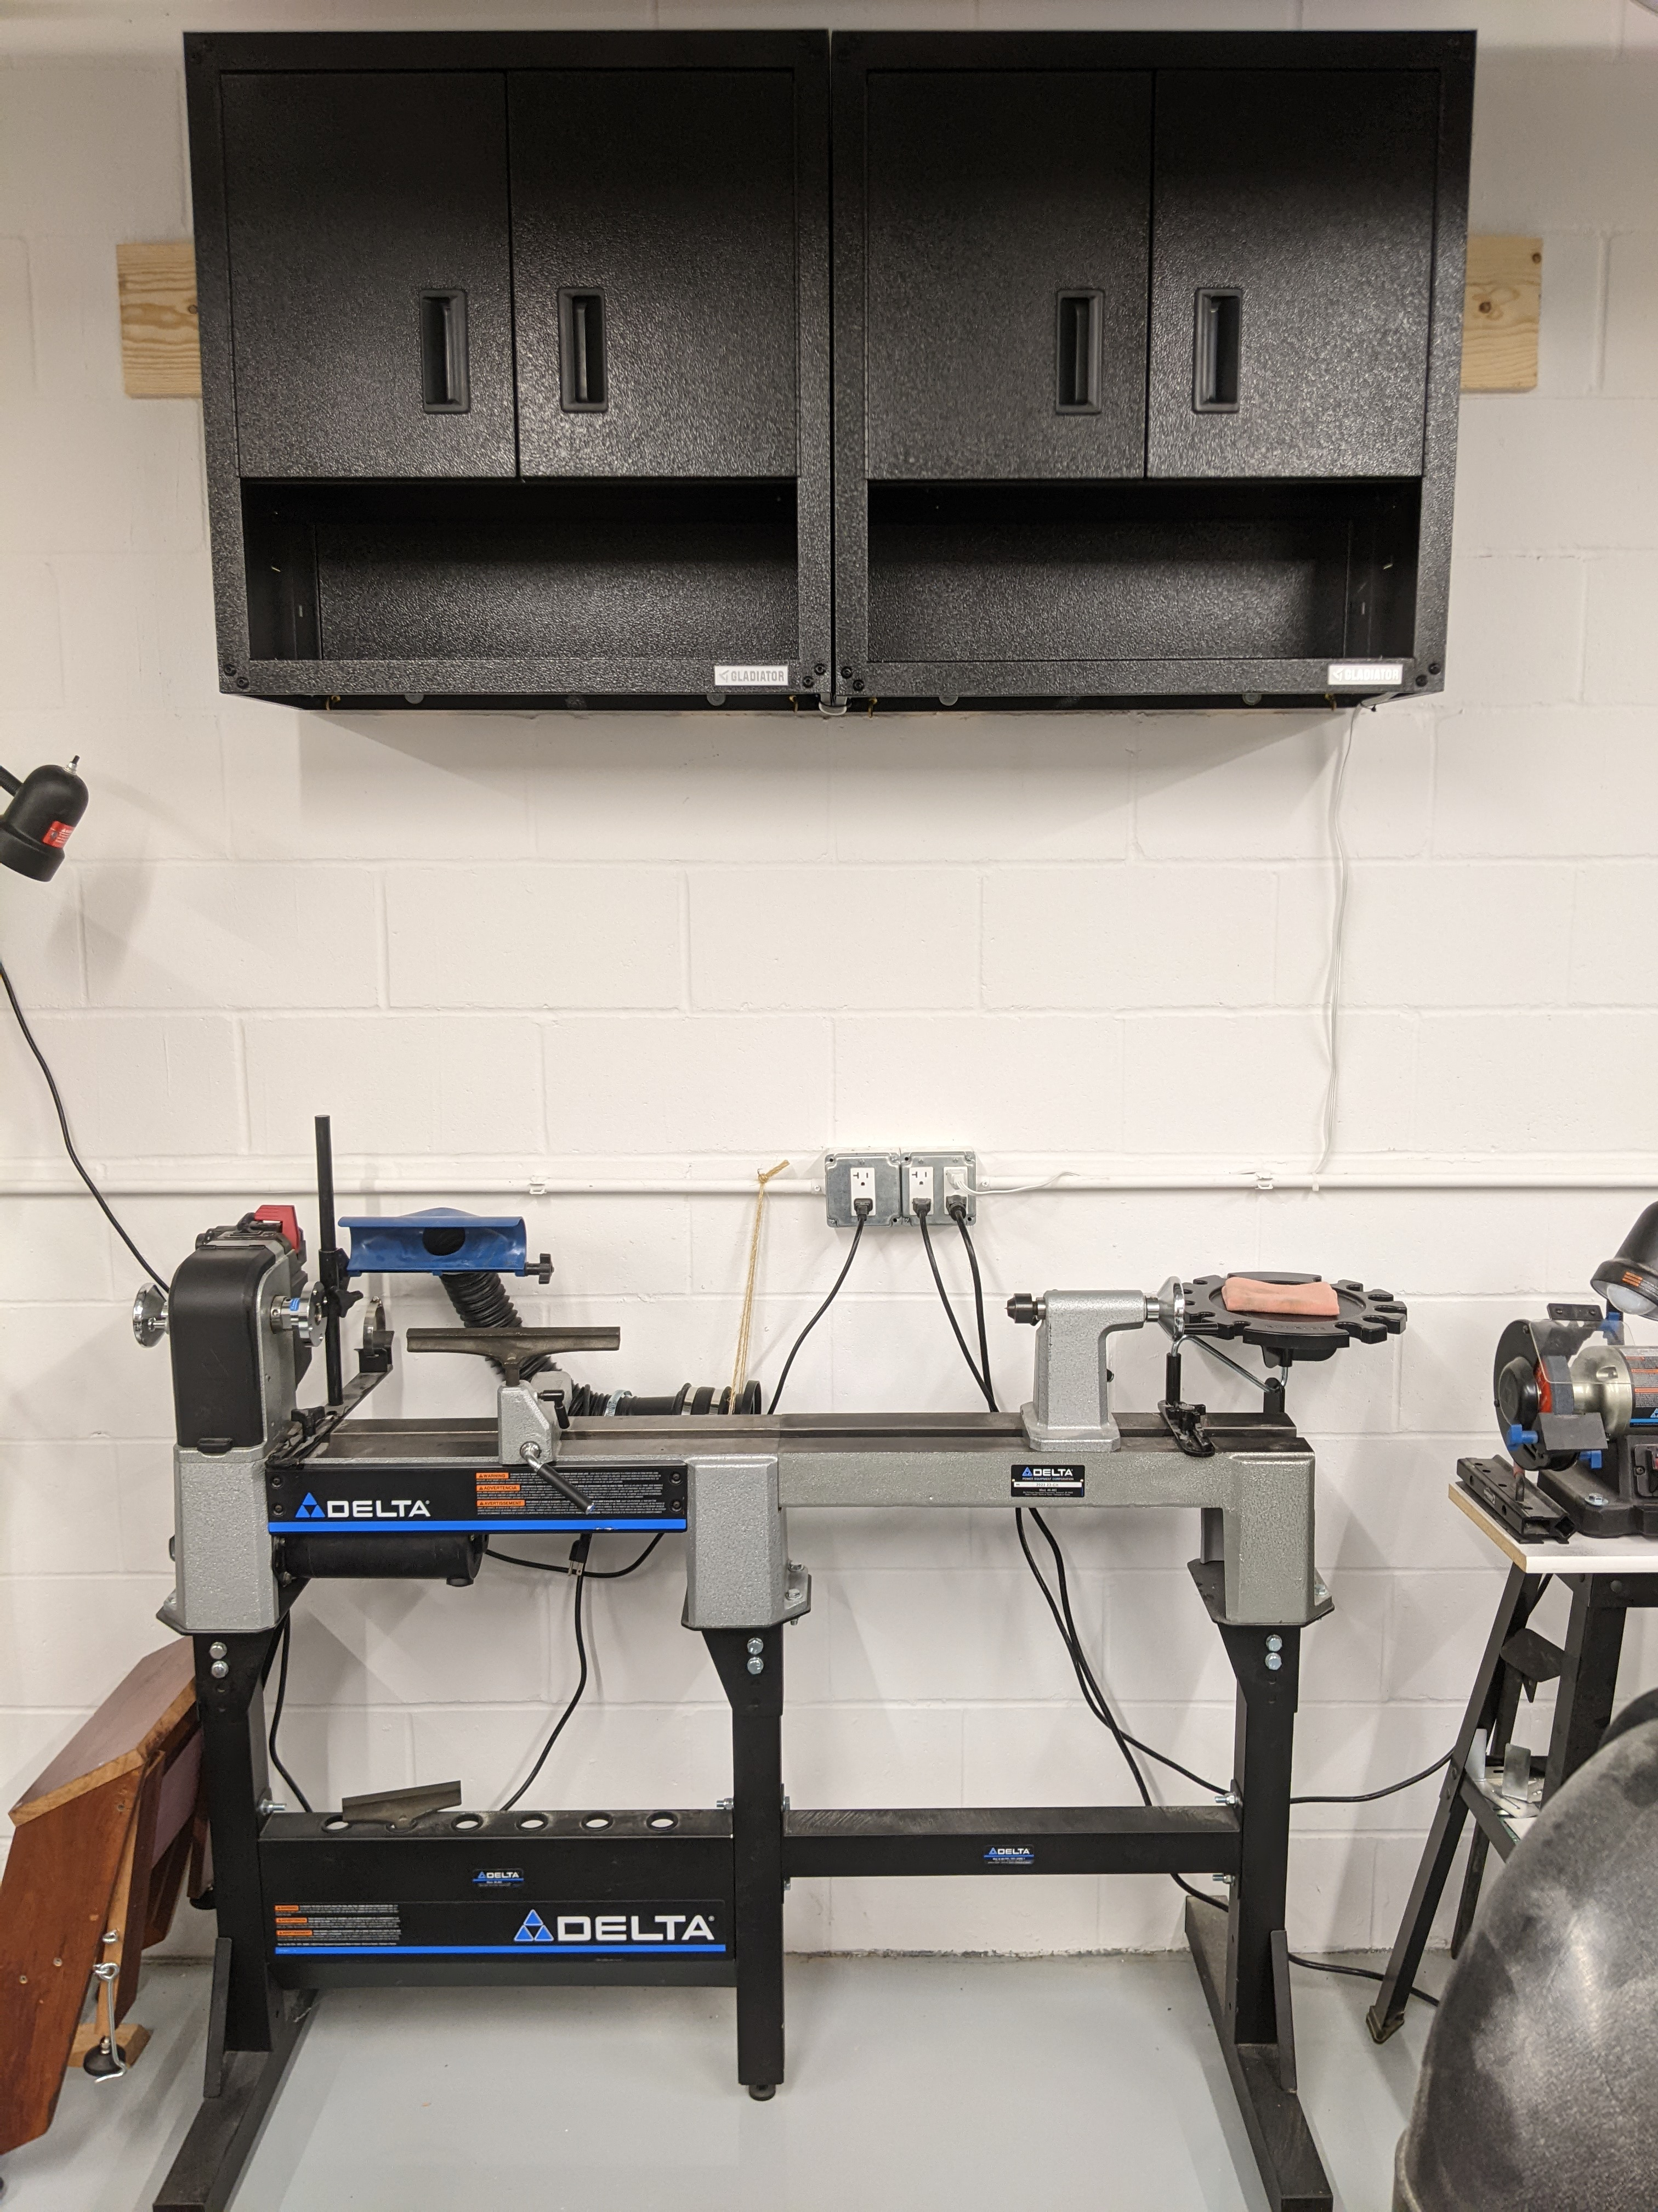

Slide 11
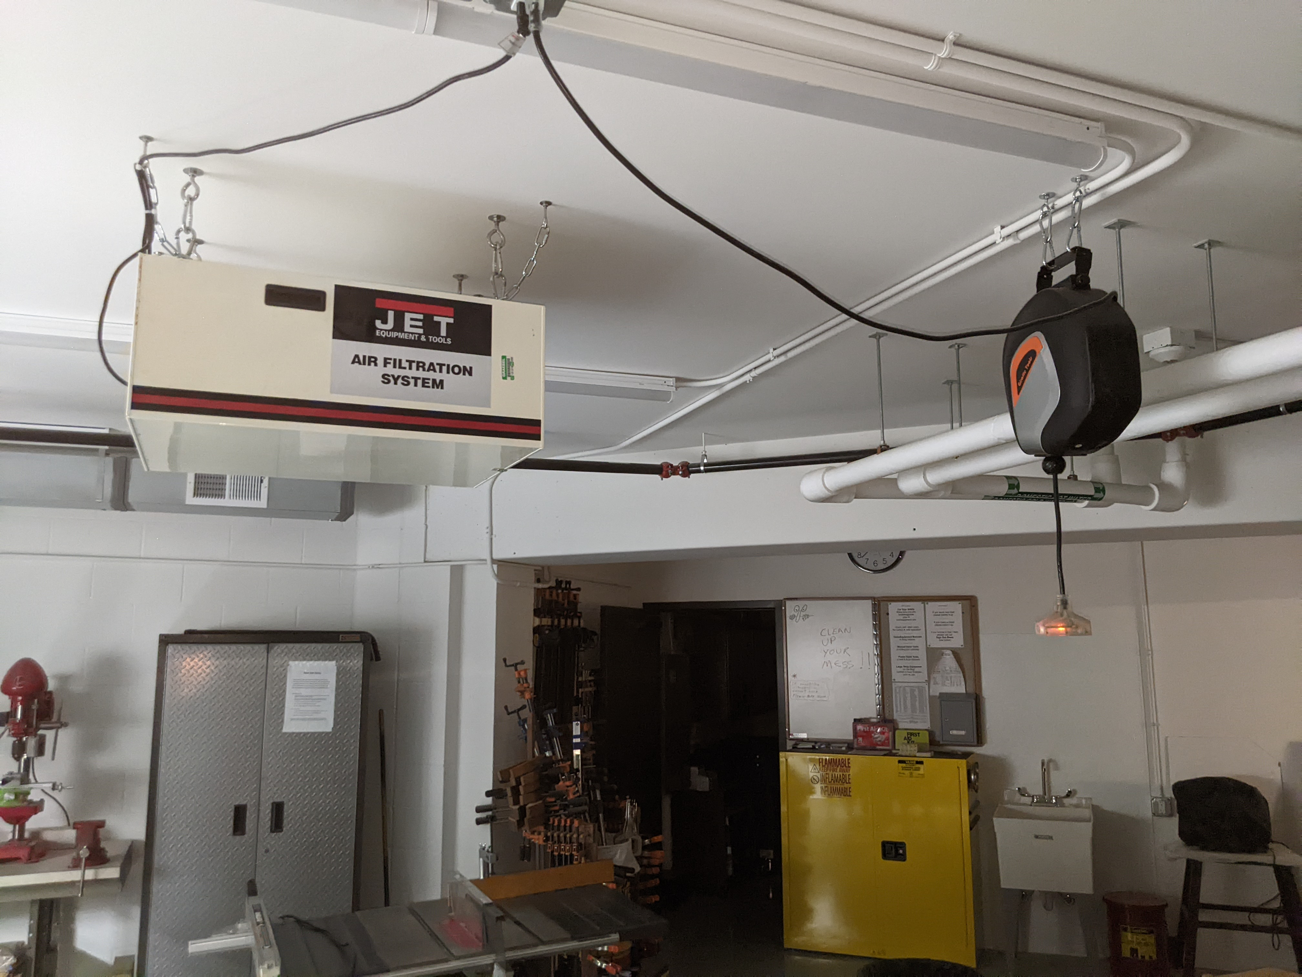

Slide 12
Before we go down to the shop...
Jack W. has a few words about workshop safety!
Ralf L. will cover some interesting operational tidbits.
In the shop...
Ralph (Our main organizational wizard!) will show where things are.
We have a lot of nice handheld power tools in cabinets.
Our storage room is stuffed with a vast variety of tools.
And a bunch of manuals.
Shelves and tool chests!
Our ”admin area” has...
A checkout sheet. (You can check things out!)
A donation box. (We are entirely self supporting.)
Copies of our Draft Users Manual.

